Slide 1
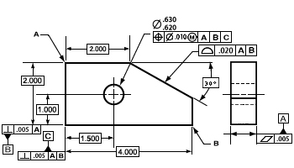


Fundamentals of
Geometric Dimensioning
& Tolerancing

Slide 2
Overview
Definition and Background
Features and Datums
Datum Reference Frame
How the GD&T System Works
Material Conditions Modifiers
Bonus Tolerance
Feature Control Frame
Major Categories of Tolerances
14 Tolerance Measurements
General Rules of GD&T
+ /- Tolerancing vs. Geometric Tolerancing

Slide 3
The GD&T Process
What is GD&T ?
  Geometric Dimensioning and Tolerancing
- Uses standard, international symbols to describe parts in a language that is clearly understood by any manufacturer.
This simple drawing shows many of the symbols that define the characteristics of a workpiece and eliminates the need for traditional handwritten notes.

Slide 4
The GD&T Process (con’t)
A significant improvement over traditional dimensioning methods in describing form, fit and function of parts.
Considered a mathematical language that is very precise.
Describes each workpiece in three “zones of tolerance” relative to the Cartesian Coordinate System.
A little history:
  Developed by Rene Descartes (pronounced day-kart), a French mathematician, philosopher and scientist.
  Descartes (Renatus Cartesius - Latin) born in 1596 in France and died in 1650.
  Formed much of the thought about the order of things in the world.
  Established three precepts about the method by which we should examine all things.

Slide 5

The GD&T Process (con’t)
First precept was most important:
“Never accept anything for true which you do not clearly know to be such.”
This idea may have been the starting point for the development of modern science.
That idea of examining everything in relation to what should be “exact and perfect” led to Descartes’ development of the Cartesian Coordinate System – a coordinate plane to make it easier to describe the position of objects.

Slide 6
The GD&T Process (con’t)
GD&T has developed as a method to question and measure the “truth” about the form, orientation, and location of manufactured parts.
Like other languages, GD&T uses special punctuation and grammar rules.
Must be used properly in order to prevent misinterpretation.
Comparable to learning a new language.

Slide 7
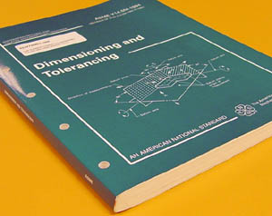
The GD&T Process (con’t)
Background:
  Standards come from two organizations:
* ASME (American Society of Mechanical Engineering)
* ISO (International Organization for Standardization)
- ASME Y14.5 and ISO 1101 are the written standards.
- Gives inspectors a clear understanding of what the designer intended.

Slide 8
The GD&T Process (con’t)
When Should GD&T be Used :
  When part features are critical to function or interchangeability.
  When functional gauging techniques are desirable.
  When datum references are desirable.
  When computerization techniques are desirable.
  When standard interpretation or tolerance is not already implied.
Why Should GD&T be Used:
  It saves money.
  Provides for maximum producibility of parts.
  Insures that design tolerance requirements are specifically stated and carried out.
  Adapts to, and assists, computerization techniques.
  Ensure interchangeability of mating parts at assembly.
  Provides uniformity and convenience in drawing.

Slide 9
The GD&T Process (con’t)
Advantages of GD&T:
  Significant improvement over traditional methods.
  Compact language, understood by anyone who learns the symbols.
  Replaces numerous notes.
  Offers greater design clarity, improved fit, better inspection methods, and more realistic tolerances.
  Ensure that:
    Good parts pass inspection.
    Bad parts are caught and rejected.
GOOD

Slide 10
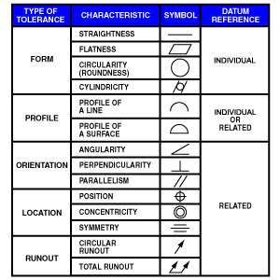
Common Tolerance Symbols
We will discuss examples of these symbols as we proceed
with the course.

Slide 11
Understanding the Terms
Radius – Two types of radii can be applied. The radius (R) distinguishes general applications. The controlled radius (CR) defines radius shapes that require further restrictions.
Statistical Tolerancing Symbol - Tolerances are sometimes calculated using simple arithmetic. If a part is designated as being statistically toleranced, it must be produced using statistical process controls.
With Size – A feature said to be “with size” is associated with a size dimension. It can be cylindrical or spherical or possibly a set of two opposing parallel surfaces.
Without Size – A plane surface where no size dimensions are indicated.
Feature Control Frames – Probably the most significant symbol in any geometric tolerancing system. Provides the instructions and requirements for its related feature.
Material Condition Modifiers – Often necessary to refer to a feature in its largest or smallest condition or regardless of its feature size.
  MMC (Maximum Material Condition)
  LMC (Least Material Condition)
  RFS (Regardless of Feature Size)

Slide 12
Datums and Features
All manufactured parts exist in two states:
- The imaginary, geometrically perfect design
- The actual, physical, imperfect part.
DATUMS:
A part design consists of many datums (each is a geometrically perfect form).
Datums can be :
- straight lines
- circles
- flat planes
- spheres
- cylinders
- cones
- a single point

Slide 13
Datums and Features (con’t)
Datums are “imaginary”. They are assumed to be “exact” for the purpose of computation or reference.
Utilizing datums for reference, the tolerances take on new meaning.
Now, features can have a tolerance relationship to each other both in terms of form and also location.

Slide 14
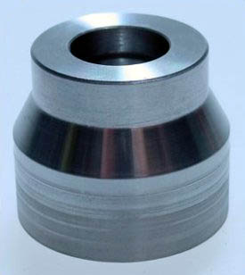
Datums and Features (con’t)
Features:
  Real, geometric shapes that make up the physical characteristics of a part.
  May include one or more surfaces:
    Holes
    Screw threads
    Profiles
    Faces
    Slots
  Can be individual or may be interrelated.
  Any feature can have many imperfections and variations.

Slide 15
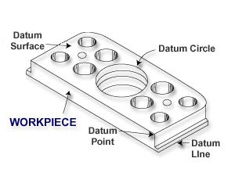
Datums and Features (con’t)
Tolerances in a design tell the inspector how much variance or imperfection is allowable before the part must be considered unfit for use.
Tolerance is the difference between the maximum and minimum limits on the dimensions of the part.
Since parts are never perfect, a datum feature is used during inspection, to substitute for the perfect datum of the drawing.
Datum features are simply referred to as datums.
We cannot make a “perfect” part.

Slide 16

The Datum Reference Frame
GD&T positions every part within a “Datum Reference Frame”.
The DRF is by far the most important concept in the geometric tolerancing system.
The skeleton, or frame of reference to which all requirements are connected.
Understanding the DRF is critical in order to grasp the concepts of
position
and
profile

Slide 17
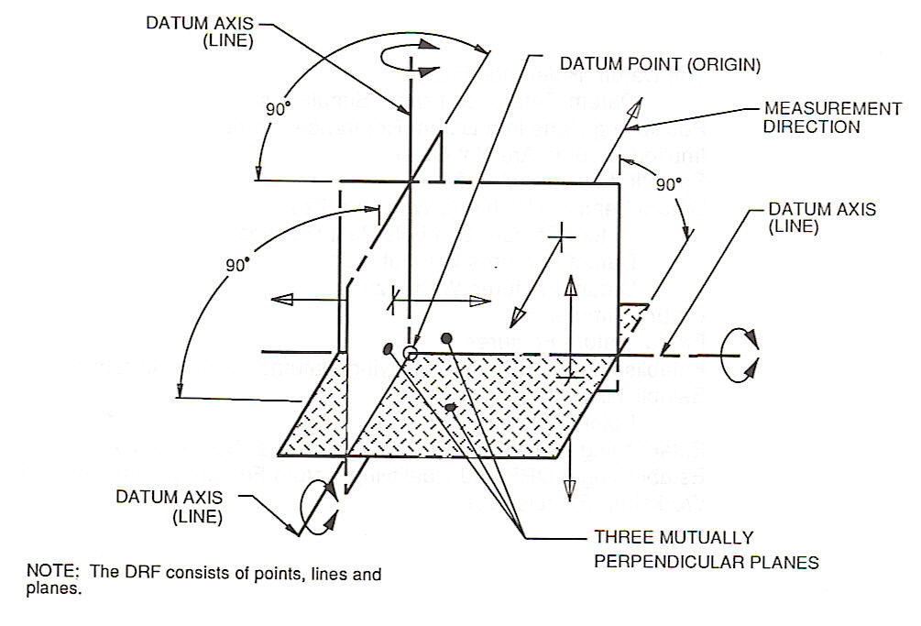
The Datum Reference Frame (con’t)
Engineering, manufacturing, and inspection all share a common “three plane” concept.
These three planes are:
  Mutually perpendicular
  Perfect in dimension and orientation
  Positioned exactly 90⁰ to each other.
This concept is called the Datum Reference Frame.

Slide 18
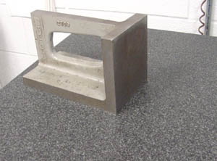
The Datum Reference Frame (con’t)
The three main features of the DRF are the planes, axes, and points.
The DRF consists of three imaginary planes, similar to the X, Y, & Z axes of the traditional coordinate measuring system.
The planes exist only in theory and make up a perfect, imaginary structure that is mathematically perfect.
All measurements originate from the simulated datum planes.
This flat, granite surface plate and the angle block sitting on it , can represent two of the three datum planes.

Slide 19
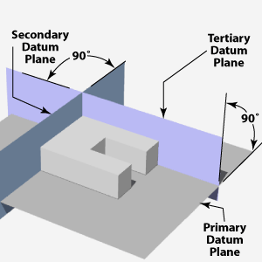
The Datum Reference Frame (con’t)
The Datum Reference Frame will
accommodate both rectangular
and cylindrical parts.
A rectangular part fits into the
corners represented by the inter-
section of the three datum planes.
The datum planes are imaginary
and therefore perfect.
The parts will vary from these planes, even though the variations will not be visible to the naked eye.
The most important concept to grasp is that when the part is placed into an inspection apparatus, it must make contact with the apparatus planes in the order specified by the feature control frame. (Primary, then secondary, then tertiary). This is the only way to assure uniformity in the measurement of different parts.

Slide 20
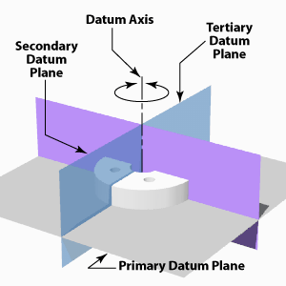
The Datum Reference Frame (con’t)
A cylindrical part rests on
the flat surface of the primary
plane and the center of the
cylinder aligns with the
vertical datum axis created
by the intersection of the planes.
In this case, it becomes very
important to be able to establish
the exact center of the part,
whether it is the center of a solid surface, or the center of a hole.
Cylindrical parts are more difficult to measure.

Slide 21
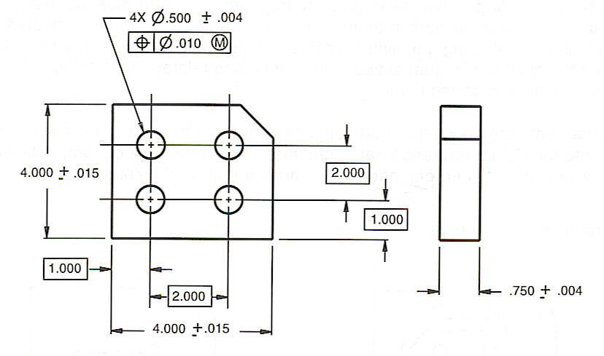
Implied Datums
The order of precedence in the selection and establishment of datums is very important.
The picture below shows a part with four holes, located from the edges with basic dimensions.
The datums are not called out in the feature control frame, but they are “implied” by the dimensions and by the edges from which those dimensions originate. Thus, we imply that these edges are the datums.

Slide 22
Implied Datums (con’t)
Problems with implied datums:
  We do not know the order in which they are used.
  We know the parts are not perfect.
  None of the edges are perfectly square.
  The 90º corners will not be perpendicular.
    In theory, even if the corners were out of perpendicularity by only .0001, the part would still “rock” back and forth in the “theoretically perfect” datum reference frame.

Slide 23
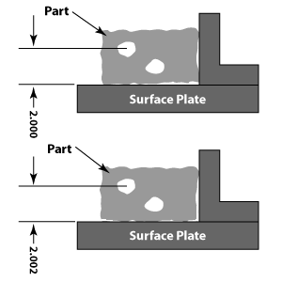
The Order of Datums
GD&T instructions designate which feature of the part will be the “primary, secondary, or tertiary” datum references.
These first, second and third datum features reflect an order of importance when relating to other features that don’t touch the planes directly.
Datum orders are important because the same part can be inspected in several different ways, each giving a different measurement.
Creating a Datum Reference Frame and an order of importance is mandatory in order to achieve interchangeable parts.
Improper positioning could result in measurement errors unless the preferred positioning in the inspection fixture is indicated in the drawing.

Slide 24
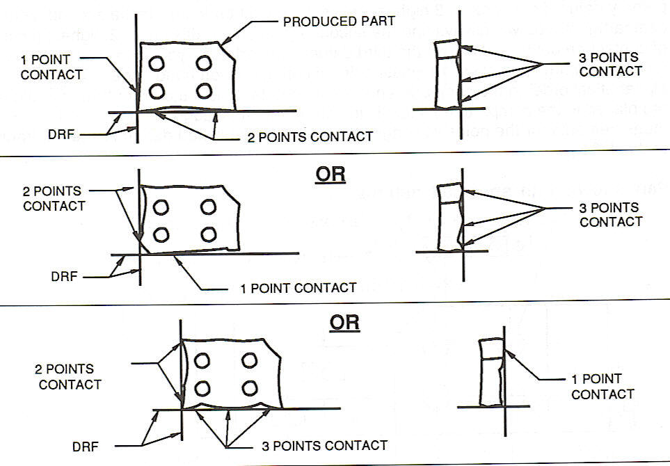
The Order of Datums (con’t)
The primary datum feature must have at least three points of contact with the part and contacts the fixture first.
The secondary has two points of contact and the tertiary has three points of contact with the part.
This process correctly mirrors the datum reference frame and positions the part the way it will be fitted and used.

Slide 25
SECTION 2 - HOW THE GEOMETRIC SYSTEM WORKS
This section introduces the geometric system and explains the major factors that control and/or modify its use.
Those important factors are:
  Plus/Minus Tolerancing
  Geometric Tolerance Zones
  The difference between geometric and limit tolerancing.
  Material Condition Modifiers
  Bonus Tolerance
  The Feature Control Frame

Slide 26
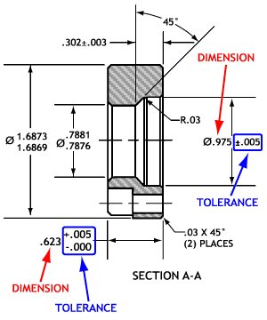
Plus / Minus Tolerancing
Plus/ Minus tolerancing, or limit tolerancing is a two-dimensional system.
When the product designer, using drafting or CAD equipment draws the part, the lines are straight, angles are perfect, and the holes are perfectly round.
When the part is produced in a manufacturing process, there will be errors.
The variations in the corners and surfaces will be undetectable to the human eye.
The variations can be picked up using precise measurements such as a CMM.

Slide 27
Plus / Minus Tolerancing (con’t)
In a plus/minus tolerancing system, the datums are implied and therefore, are open to varying interpretations.
Plus/minus tolerancing works well when you are considering individual features. However, when you are looking at the relationship between individual features, plus/minus tolerancing is extremely limited.
With the dawn of CAD systems and CMMs, it has become increasingly important to describe parts in three dimensional terms, and plus/minus tolerancing is simply not precise enough.

Slide 28
Geometric Tolerance Zones
A geometric tolerancing system establishes a coordinate system on the part and uses limit tolerancing to define the form and size of each feature.
Dimensions are theoretically exact and are used to define the part in relation to the coordinate system.
The two most common geometric characteristics used to
define a feature are position and profile of the surface.

Slide 29
Geometric Tolerance Zones (con’t)
Referring to the angle block below, position tolerance is located in the first block of the feature control frame. It specifies the tolerance for the location of the hole on the angle block. The “boxed dimensions” define what the exact location of the center of the hole should be. 1.000 x 1.500. The position tolerance block states that the center of the hole can vary no more than .010 inches from that perfect position, under Maximum Material Condition. The position tolerance zone determines the ability of the equipment used to produce the part within limits. The tighter the position tolerance is, the more capable the equipment. Position tolerance is merely a more concise manner in which to communicate production requirements.

Slide 30
Geometric Tolerance Zones (con’t)
Profile tolerance (half-circle symbol) is specified in the second block of the feature control frame. It is used to define a three dimensional uniform boundary that the surface must lie within. The tightness of the profile tolerance indicates the manufacturing and verification process. Unimportant surfaces may have a wide tolerance range, while important surfaces will have a very tight profile tolerance range.
Form tolerance refers to the flatness of the part while orientation tolerance refers to the perpendicularity of the part specified on the datums. These two tolerances are chosen by the designer of the part in order to match the functional requirements of the part. Form and orientation tolerances control the instability of the part.

Slide 31
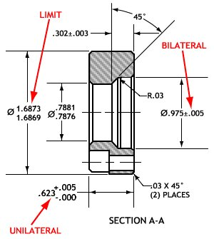
Geometric vs. Bilateral, Unilateral & Limit Tolerancing
The difference between “geometrically toleranced” parts and “limit toleranced” parts is quite simple. Geometric tolerances are more precise and clearly convey the intent of the designer, using specified datums. It uses basic dimensions which are theoretically exact and have zero tolerance.
Limit tolerancing produces a part that uses implied datums and larger, less exact tolerances that fall into three basic categories:
Bilateral tolerances specify the acceptable measurements in two opposite directions from a specified dimension.
Unilateral tolerances define the acceptable range of measurements in only one direction from a given dimension.
Limit dimensions give the acceptable measurements within two absolute dimensions.

Slide 32
Material Condition Modifiers
Used in geometric tolerancing.
Have tremendous impact on stated tolerance or datum reference.
Can only be applied to features and datums that specify size. (holes, slots, pins, tabs). If applied to features that are without size, they have no impact.
If no modifier is specified in the feature control frame, the default modifier is “RFS” – regardless of feature size.
There are three material condition modifiers:
  Maximum Material Condition – (MMC) – This modifier gives room for additional position tolerance of up to .020 as the feature departs from the maximum material condition. This is a condition of a part feature wherein, it contains the maximum amount of material, or the minimum hole-size and maximum shaft-size.
.245
.255
Emphasis is on
the word “Material”.
.250 + .005
.250 + .005

Slide 33
Material Condition Modifiers (con’t)
  Least Material Condition – (LMC) – This is the opposite of the MMC concept. This is a part feature which contains the least amount of material, or the largest hole-size and smallest shaft-size.
.255
.245
.250 + .005
.250 + .005
Regardless of Feature Size – (RFS) – This is a term used to
indicate that a geometric tolerance or datum reference applies at
any increment of size of the feature within its size tolerance.
RFS is stricter and greatly affects the part’s function, but is
necessary for parts that require increased precision.

Slide 34

Bonus Tolerance
Material condition modifiers give inspectors a powerful method of checking shafts and holes that fit together.
Both MMC and LMC modifiers allow for bonus tolerance.
This hole has a certain position tolerance, but at MMC, the hole is smaller, tighter, and exhibits a perfect cylindrical form.
As more material is removed from around the hole, the space is larger and provides a looser fit for the shaft. Therefore, the position tolerance for the hole can be increased, and both the shaft and the hole will still fit. This increased tolerance is called the bonus tolerance of the hole and changes as the size of the hole increases.
Hole drilled at MMC
Bonus Tolerance
Hole drilled at LMC

Slide 35
The Feature Control Frame
GD&T instructions contain a large amount of information.
Each feature is given a feature control frame.
Frame reads from left to right, like a basic sentence.
Instructions are organized into a series of symbols that fit into standardized compartments.

Slide 36
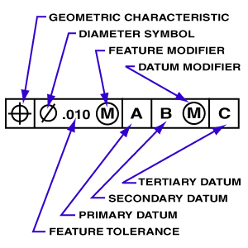
The Feature Control Frame (con’t)
  The first compartment defines the geometric characteristic of the feature, using one of the 14 standard geometric tolerance symbols ( means “position”). A second feature control frame is used if a second geometric tolerance is needed.
  The second compartment contains the entire tolerance for the feature, with an additional diameter symbol to indicate a cylindrical or circular tolerance zone. No additional symbol is needed for parallel lines or planes. If needed, material condition modifiers would also appear in the second compartment.

Slide 37
The Feature Control Frame (con’t)
The third compartment indicates the primary datum which locates the part within the datum reference frame. Every related tolerance requires a primary datum but independent tolerances, such as form tolerances, do not.
The fourth and fifth compartments contain the secondary and tertiary datums. Depending on the geometric tolerance and the function of the part, secondary and tertiary datums may not be necessary.

Slide 38
Straight & Cylindrical Tolerances
Section 3
Types of Tolerances – 5 major groups.
- Form Tolerances (flatness, circularity, cylindricity & straightness.
- Profile Tolerances (profile of surface, profile of line).
Powerful tolerances that control several aspects.
- Orientation Tolerances (perpendicularity, parallelism, and angularity).
- Location Tolerances (concentricity, symmetry, and position).
- Runout Tolerances (circular and total). Used only on cylindrical parts.

Slide 39
Straight & Cylindrical Tolerances (con’t)
An individual tolerance is not related to a datum. A related tolerance must be compared to one or more datums.

Slide 40
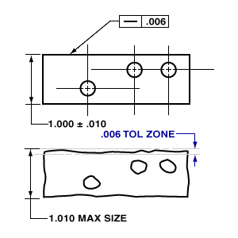
Straightness and Flatness
Two types of form tolerances.
Both define a feature independently.
- Straightness is a two-dimensional tolerance.
Edge must remain within two imaginary parallel lines to meet straightness tolerance. Distance between lines is determined by size of specified tolerance.
- Most rectangular parts have a straightness tolerance.
- Edge or center axis of a cylinder may have a straightness tolerance.
Greatly exaggerated

Slide 41
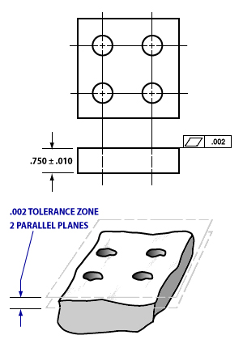
Straightness and Flatness (con’t)
Flatness is a three-dimensional version of straightness tolerance.
- Requires a surface to be within two imaginary, perfectly flat, perfectly parallel planes.
- Only the surface of the part, not the entire thickness, is referenced to the planes.
- Most often used on rectangular or square parts.
- If used as a primary datum, flatness must be specified in the drawing.

Slide 42
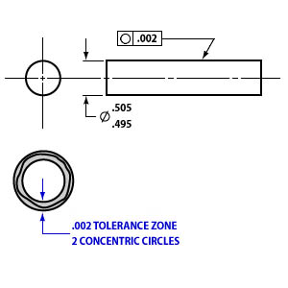
Circularity and Cylindricity
Circularity (often called roundness).
- Two-dimensional tolerance.
- Most often used on cylinders.
- Also applies to cones and spheres.
- Demands that any two-dimensional cross-section of a round feature must stay within the tolerance zone created by two concentric circles.
- Most inspectors check multiple cross-sections.
- Each section must meet the tolerance on its own.

Slide 43
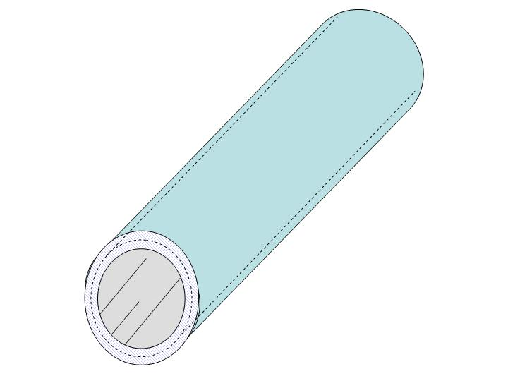
Circularity and Cylindricity (con’t)
Cylindricity specifies the roundness of a cylinder along its entire length.
- All cross-sections of the cylinder must be measured together, so cylindricity tolerance is only applied to cylinders.
Circularity and cylindricity cannot be checked by measuring various diameters with a micrometer.
Part must be rotated in a high-precision spindle. Best method would be to use a Coordinate Measuring Machine (CMM).
The thickness of the wall of a pipe represents the cylindricity tolerance zone.

Slide 44
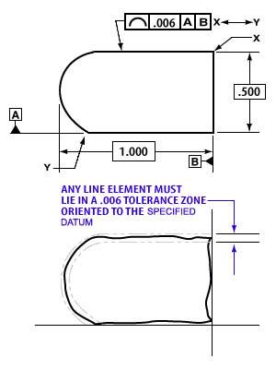
Profile of a Line and Surface
The two versions of profile tolerance.
Both can be used to control features such as cones, curves, flat or irregular surfaces, or cylinders.
A profile is an outline of the part feature in one of the datum planes.
They control orientation, location, size and form.
The profile of a line is a two-dimensional tolerance.
- It requires the profile of a feature to fall within two imaginary parallel lines that follow the profile of the feature.

Slide 45
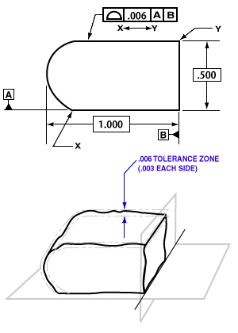
Profile of a Line and Surface (con’t)
Profile of a Surface is three-dimensional version of the line profile.
- Often applied to complex and curved contour surfaces such as aircraft and automobile exterior parts.
- The tolerance specifies that the surface must remain within two three-dimensional shapes.

Slide 46
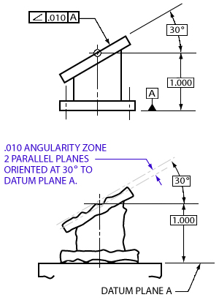
Orientation and Location Tolerances
Section 4
Angularity, Perpendicularity, and Parallelism
- These tolerances define the angle and orientation of features as they relate to other features.
- They specify how one or more datums relate to the primary toleranced feature. (Relational Tolerances)
Angularity - A three-dimensional tolerance.
* Shape of the tolerance zone depends on shape of the feature.
* If applied to flat surface, tolerance zone becomes two imaginary planes, parallel to ideal angle.
* If applied to a hole, it is referenced to an imaginary cylinder existing around the ideal angle and center of the hole must stay within that cylinder.

Slide 47
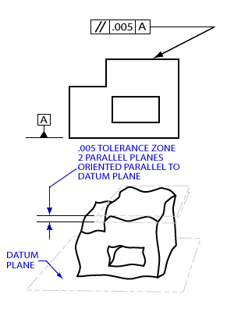
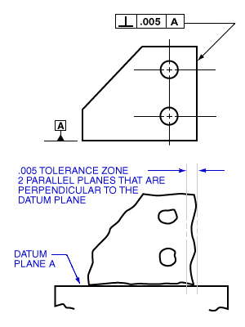
Orientation and Location Tolerances (con’t)
Perpendicularity and Parallelism : Three-dimensional tolerances that use the same tolerance zones as angularity.
Difference is that parallelism defines two features that must remain parallel to each other, while perpendicularity specifies a 90-degree angle between features.
Parallelism
Perpendicularity

Slide 48
Orientation and Location Tolerances (con’t)
Parallelism and Flatness are often confused.
- Flatness is not related to another datum plane.
When an orientation tolerance is applied to a flat surface, it indirectly defines the flatness of the feature.

Slide 49
Orientation and Location Tolerances (con’t)
Position is one of most common location tolerances.
- A three-dimensional, related tolerance.
- Ideal, exact location of feature is called
true position.
- Actual location of a feature is compared to the ideal true position.
- Usually involves more than one datum to determine where true position should be.
- Has nothing to do with size, shape, or angle, but rather “where it is”.

Slide 50
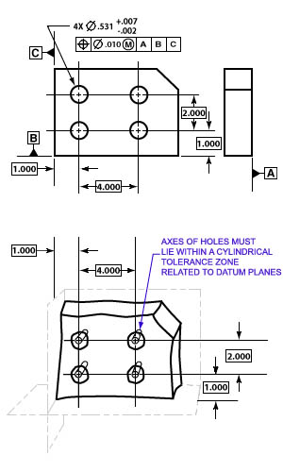
Orientation and Location Tolerances (con’t)
In the case of holes, the tolerance involves the center axis of the hole and must be within the imaginary cylinder around the intended true position of the hole.
If toleranced feature is rectangular, the zone involves two imaginary planes at a specified distance from the ideal true position.
Position tolerance is easy to inspect and is often done with just a functional gage (go / no-go gage).

Slide 51
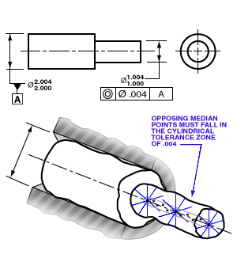
Orientation and Location Tolerances (con’t)
Concentricity and Symmetry are both three-dimensional tolerances.
Concentricity is not commonly measured.
- It relates a feature to one or more other datum features.
- This shaft is measured in multiple diameters to ensure that they share a common center-axis.

Slide 52
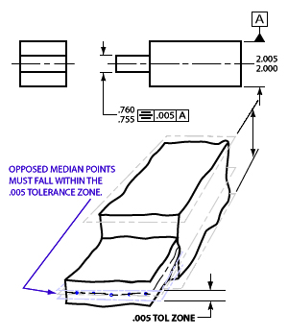
Orientation and Location Tolerances (con’t)
- Symmetry is much like concentricity.
* Difference is that it controls rectangular features and involves two imaginary flat planes, much like parallelism.
* Both symmetry and concentricity are difficult to measure and increase costs of inspection.
* When a certain characteristic, such as balance, is important, these tolerances are very effective.

Slide 53
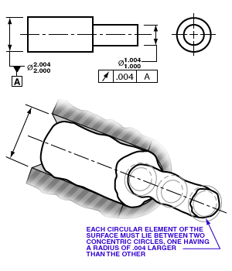
Orientation and Location Tolerances (con’t)
Circular and Total Runout are three-dimensional and apply only to cylindrical parts.
Both tolerances reference a cylindrical feature to a center datum-axis, and simultaneously control the location, form and orientation of the feature.
Circular runout can only be inspected when a part is rotated.
- Calibrated instrument is placed against the surface of the rotating part to detect the highest and lowest points.
- The surface must remain within two imaginary circles, having their centers located on the center axis.

Slide 54
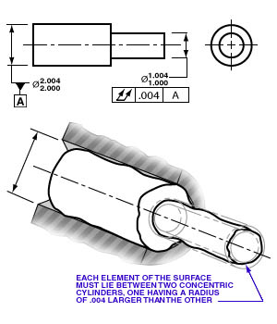
Orientation and Location Tolerances (con’t)
Total Runout is similar to circular runout except that it involves tolerance control along the entire length of, and between, two imaginary cylinders, not just at cross sections.
- By default, parts that meet total runout tolerance automatically satisfy all of the circular runout tolerances.
- Runout tolerances, especially total runout, are very demanding and present costly barriers to manufacturing and inspection.

Slide 55
GENERAL RULES OF GD&T
Geometric dimensioning and tolerancing is based on certain fundamental rules. Some of these follow from standard interpretation of the various characteristics, some govern specification, and some are General Rules applying across the entire system.
Rule #1 is the Taylor Principle, attributed to William Taylor who in 1905 obtained a patent on the full form “go-gage”. It is referred to as Rule #1 or “Limits of Size” in the Y14.5M, 1994 standard. The Taylor Principle is a very important concept that defines the size and form limits for an individual feature of size. In the international community the Taylor Principle is often called the “envelope principle”.

Slide 56
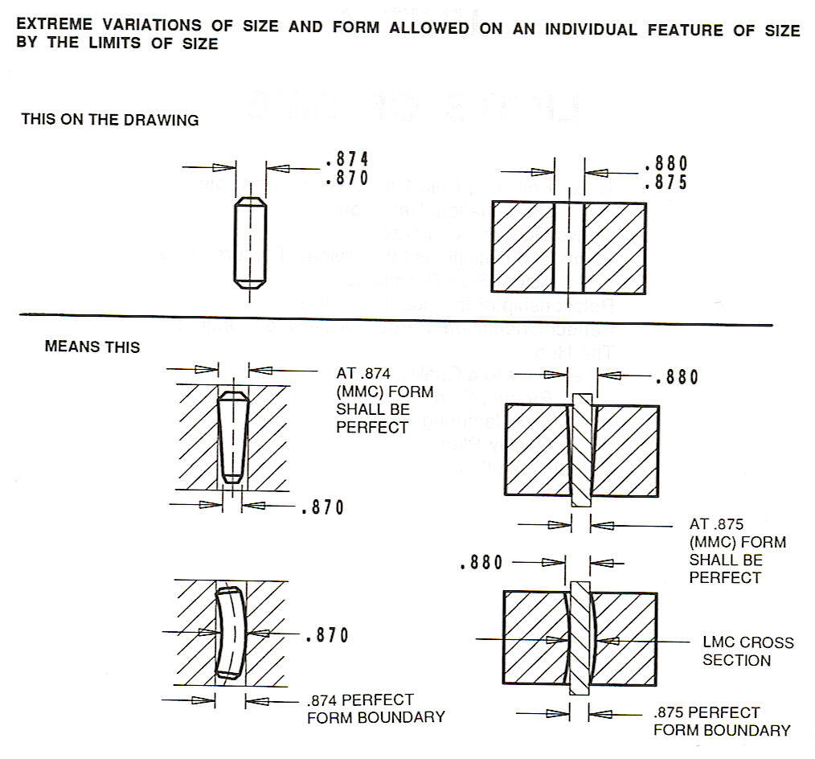
GENERAL RULES OF GD&T (con’t)
Variations in size are possible while still keeping within the perfect boundaries. The limits of size define the “size” (outside measurements) as well as the “form” (shape) of a feature. The feature may vary within the limits. That is, it may be bent, tapered, or out of round, but if it is produced at its maximum material condition, the form must be perfect. (or, as close as possible)

Slide 57
GENERAL RULES OF GD&T (con’t)
Individual Feature of Size:
  When only a tolerance of size is specified, the limits of size of an individual feature prescribe the extent to which variations in its geometric form as well as size are allowed.
Variation of Size:
  The actual size of an individual feature at any cross section shall be within the specified tolerance size.

Slide 58
GENERAL RULES OF GD&T (con’t)
Variation of Form:
The form of an individual feature is controlled by its limits of size to the extent prescribed in the following paragraph and illustration.
  The surface or surfaces of a feature shall not extend beyond a boundary (envelope) of perfect form at Maximum Material Condition (MMC). This boundary is the true geometric form represented by the drawing. No variation is permitted if the feature is produced at its MMC limit of size. (Plain English- If the part is produced at Maximum Material Condition, it shall not be bigger than the perfect form of the drawing.)
  Where the actual size of a feature has departed from MMC toward LMC, a variation in form is allowed equal to the amount of such departure.
  There is no requirement for a boundary of perfect form at LMC. Thus, a feature produced at LMC limit of size is permitted to vary from true form to the maximum variation allowed by the boundary of perfect form at MMC.

Slide 59
GENERAL RULES OF GD&T (con’t)
Rule #2 – Applicability of MMC, LMC, & RFS :
In the current ASME Y14.5M-1994, Rule # 2 governs the applicability of modifiers in the Feature Control Frame. The rule states that “Where no modifying symbol is specified with respect to the individual tolerance, datum reference, or both, then RFS (Regardless of Feature Size) automatically applies and is assumed. Since RFS is implied, it is not necessary to include the symbol. Therefore, the symbol S has been eliminated from the current standard.
MMC and LMC must be specified where required.
Rule #3 – Eliminated:
Rule #4 & #5 - Eliminated:

Slide 60
GENERAL RULES OF GD&T (con’t)
What is Virtual Condition ?
Depending upon its intended purpose, a feature may be controlled by tolerances such as form, size, orientation and location. The collective (total) effects of these factors determine the clearances between mating parts and they establish gage feature sizes. The collective effect of these factors is called “virtual condition”.
Virtual condition is a constant boundary created by the total effects of a “size” feature based on its MMC or LMC condition and the geometric tolerance for that material condition.

Slide 61
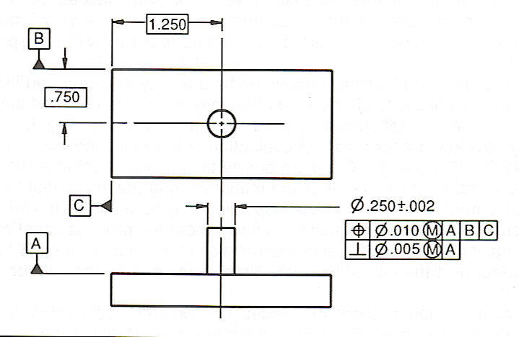
GENERAL RULES OF GD&T (con’t)
The size tolerance for the pin (.250 + .002) and the location and perpendicularity tolerances listed in the Feature Control Frame combine to create two possible virtual sizes. First, regardless of its position or angle, the pin must still lie within the .002 boundary specified for its width. However, the tolerance for perpendicularity allows a margin of .005. So, if the part were produced at MMC to .252 and it deviates from perpendicularity by the .005 allowed, the total virtual size of the pin can be considered to be .257 in relation to datum A.

Slide 62
GENERAL RULES OF GD&T (con’t)
Second, the position tolerance of .010 combined with the size tolerance of .002 would produce a virtual size of .262 in relation to datums A, B and C.
This means that an inspection gage would have to have a hole of .262 to allow for the combined tolerances, even though the pin can be no more than .252 diameter. Therefore, three inspections would be necessary in order to check for size, perpendicularity, and location.

Slide 63
GENERAL RULES OF GD&T (con’t)
Virtual size of a hole
  When calculating the virtual size of a hole, you must remember the rule concerning Maximum Material Condition (MMC) and Least Material Condition (LMC) of holes. Recall that when machining a hole, MMC means the “most material that can remain in the hole”. Therefore, a hole machined at MMC will be smaller and a hole machined at LMC will be larger. It is important to read the Feature Control Frame information carefully to make sure you understand which feature is specified and what material conditions are required.

Slide 64
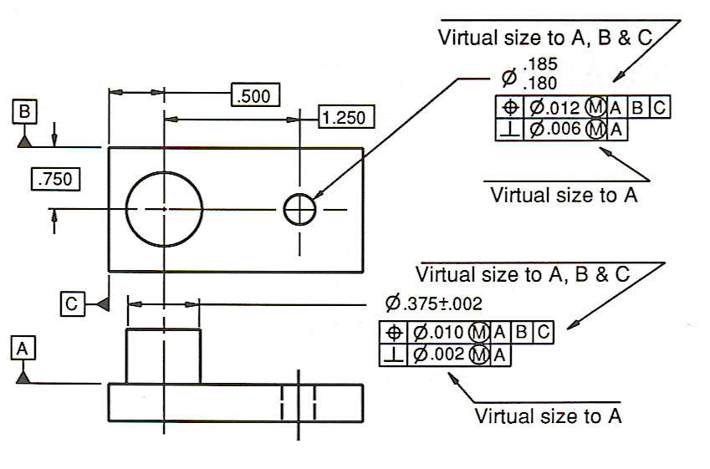
GENERAL RULES OF GD&T (con’t)
Calculate the virtual sizes for the indicated features.
.
.192
.186
.387
.379

Slide 65
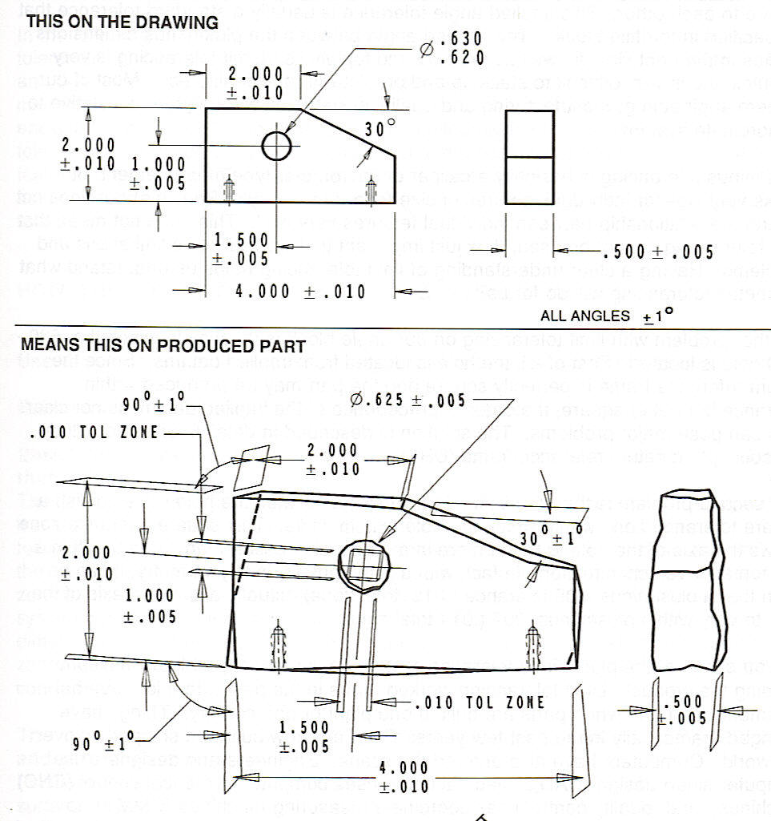
Limit (+/-) Tolerancing vs. Geometric Tolerancing
Limit Tolerancing (+/-) is restricted when inspecting all features of a part and their relationships.
  (+/-) is basically a two-dimensional tolerancing system (a caliper/ micrometer type measurement.
  Works well for individual features.
  Does not control the relationship between individual features.

Slide 66
Limit (+/-) Tolerancing vs. Geometric Tolerancing
Visually, the block will look straight and square. The variations will be so small that they are undetectable with the human eye. However, when the parts are inspected using precision measuring equipment such as a CMM, the angle block starts to look like the bottom drawing (greatly exaggerated).
The block is not square in either view. The surfaces are warped and not flat. The hole is not square to any surface and it is not round. It is at this point that the limit system of tolerance breaks down. Plus/minus tolerances are two dimensional; the actual parts are three dimensional. Limit tolerances usually do not have an origin or any location or orientation relative to datums. The datums are usually implied. Most of our modern engineering, manufacturing and quality systems all work square or relative to a coordinate system. Parts must be described in a three dimensional mathematical language to ensure clear and concise communication of information relating to product definition. That is why we need geometric tolerancing.

Slide 67
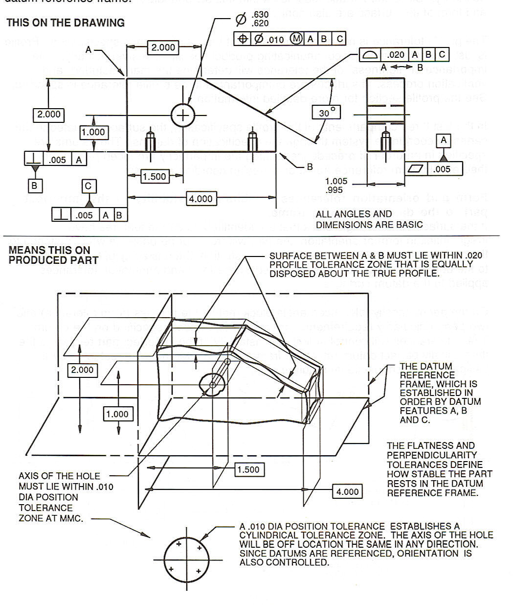
Limit (+/-) Tolerancing vs. Geometric Tolerancing
The same angle block is now done with geometrics.
  Notice that datums A, B and C have been applied to features on the part establishing a X, Y and Z Cartesian coordinate system.
  Geometrics provides a very clear, concise three dimensional mathematical language for product definition.

Slide 68
Limit (+/-) Tolerancing vs. Geometric Tolerancing
A close-up look at the angle block shows how the features are controlled. For example, the hole location is controlled by the feature control frame shown below.
Hole Location Tolerance Zone
.630
.620
.010
M
A
B
C
.010 Tolerance Zone
1.000
1.500
The MMC condition dictates a smaller position tolerance. If the hole is made to the Least Material Condition (LMC), resulting in a larger hole, then the hole location can be farther off and still align with the mating pin.
.010 when hole size is .620 (MMC)
.020 when hole size is .630 (LMC)

Slide 69
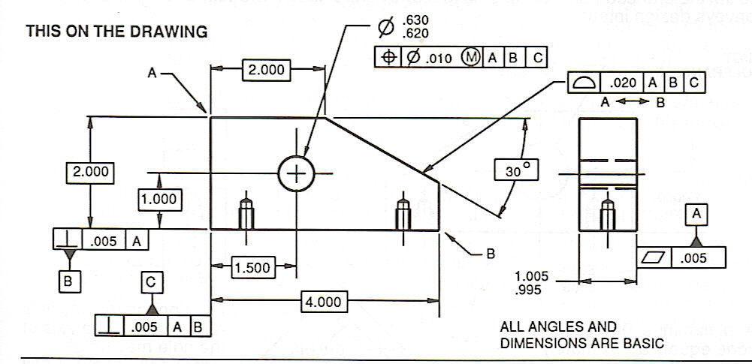
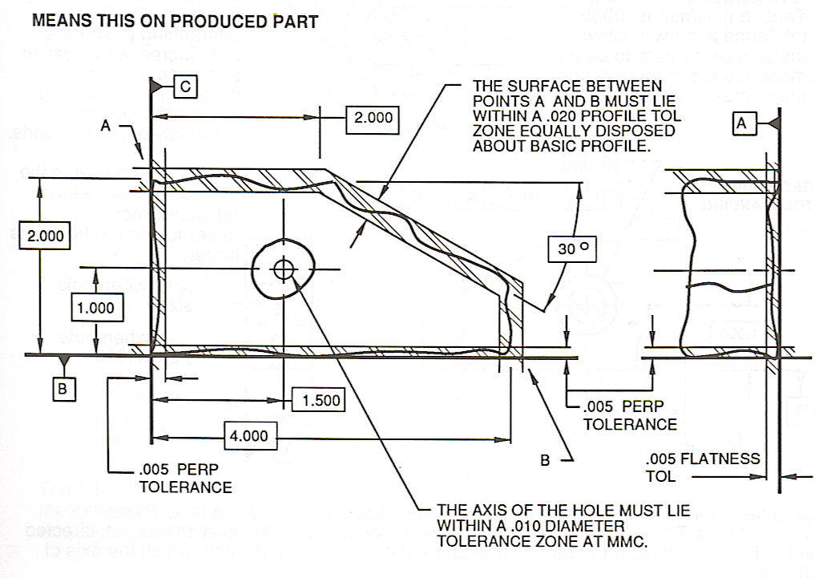
Limit (+/-) Tolerancing vs. Geometric Tolerancing
Geometric Tolerancing Applied to an Angle Block – 2D View
The above drawing depicts the part as the designer intended it to be. In reality, no part can ever be made perfect. It will always be off by a few millionths of an inch. With that in mind, the drawing on the right illustrates how the GD&T instructions control the features of the part. The drawing is greatly exaggerated to show what would be undetectable by the naked eye.

Slide 70
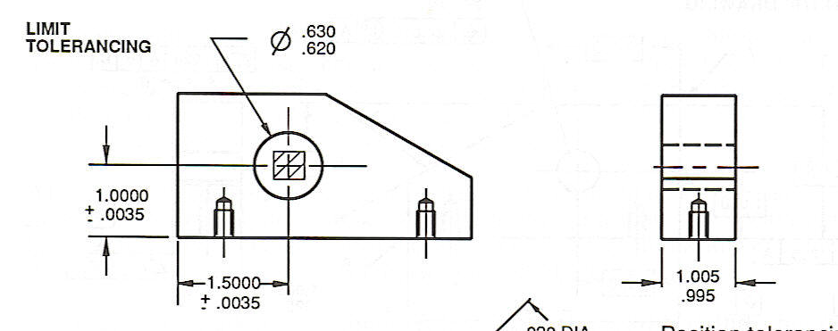
Limit (+/-) Tolerancing vs. Geometric Tolerancing
Geometric Tolerancing –vs- Limit Tolerancing – What’s The Difference?
  This drawing is produced using limit tolerancing. There is no feature control frame, so the design relies on the limits established by the + dimensions, and the datums are all “implied”.

Slide 71
Limit (+/-) Tolerancing vs. Geometric Tolerancing
Notice that the position of the hole is implied as being oriented from the lower left hand corner. Because we are forced to use the plus/minus
.0035 limit tolerance, the hole tolerance zone ends up looking like a square. A close look at the part reveals that the axis of the hole can be off farther in a diagonal direction than across the flat sides.
1.000 + .0035
1.500 + .0035

Slide 72
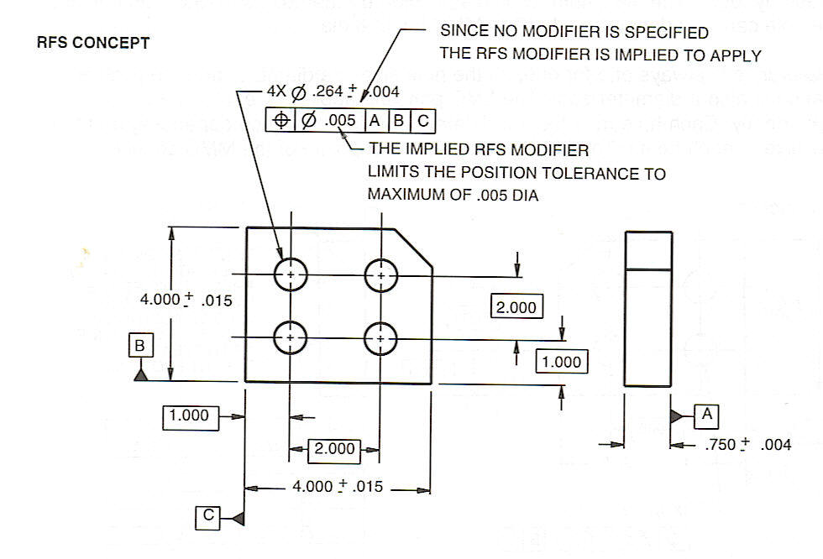
Limit (+/-) Tolerancing vs. Geometric Tolerancing
Regardless of Feature Size – RFS
  Modifier rule # 2 states that unless otherwise specified, all geometric tolerances are by default implied to be RFS – Regardless of Feature Size. Since all unspecified tolerances apply at RFS, there is no need for a RFS symbol. The drawing below illustrates how RFS affects the location tolerance of a feature.
What this means to the machinist is that no matter if the holes are machined at the upper limit of .268 or the lower limit of .260, their location is still restricted to the .005 position tolerance zone.

Slide 73
Summary
GD&T (geometric dimensioning and tolerancing) is an international design standard.
Uses consistent approach and compact symbols to define and control the features of manufactured parts.
Is derived from the two separate standards of ASME Y14.5M and ISO 1101.
Technically, GD&T is a drafting standard.

Slide 74
Summary
Helps inspectors improve their methods by emphasizing fit, form and function.
Compares the physical, imperfect features of a part to its perfect, imaginary form specified in the design drawing.
Controls flatness, straightness, circularity, cylindricity, and four form tolerances that independently control a feature.
Other tolerances, such as location, runout, and orientation must be referenced to another datum.

Slide 75
Summary
The profile tolerances can define a feature independently.
A related datum can further define the orientation and location.
A series of internationally recognized symbols are organized into a feature control frame.
The control frame specifies the type of geometric tolerance, the material condition modifier, and any datums that relate to the feature.

